Slide 1
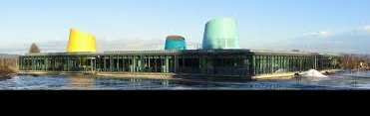
Råholt Secondary School
Norway

Slide 2
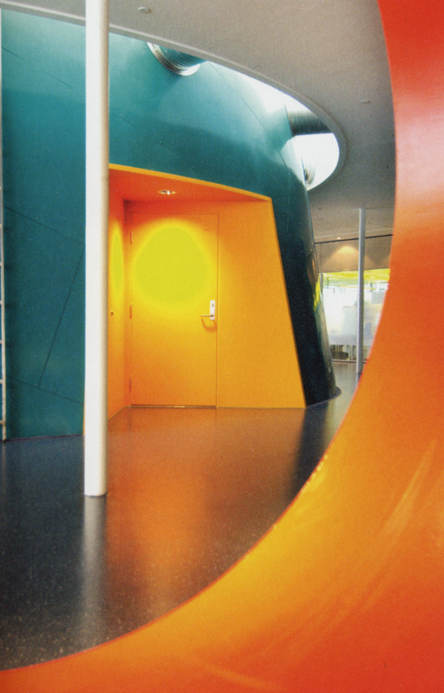
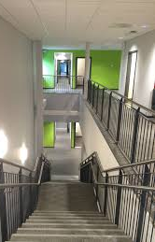
530 pupils: year 8 year 9 year 10 70 teachers and staff

Slide 3
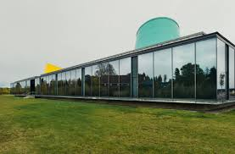
The project so far:
We have chosen a project to improve our local environment by taking care of the bees. This year pupils have made insect hotels, and for the next phase of the project the pupils are going to establish a bee garden with a wide range of wild flowers.

Slide 4
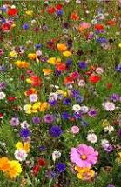
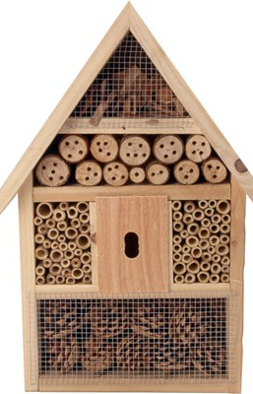
Going forward:
Take inspiration from the rest of the schools in the project.
Look at the possibility of expanding the project to involve more pupils and subjects. (Covid-19 has made us start small)

