Slide 1
Basic school Javornického vysOKÉ Mýto
Created by: Markéta Kotasová
BASIC SCHOOL TEACHER
CZECH REPUBLIC

Slide 3
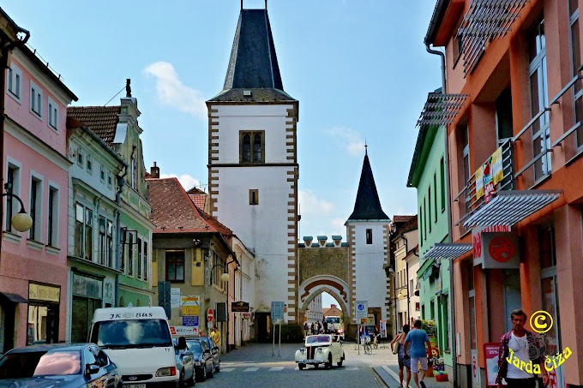
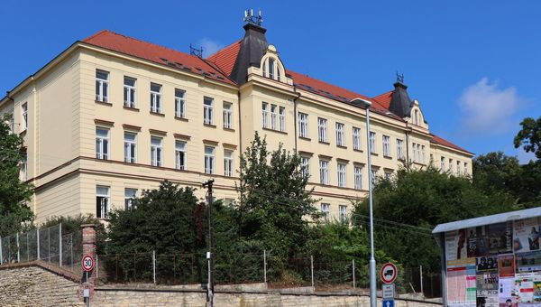
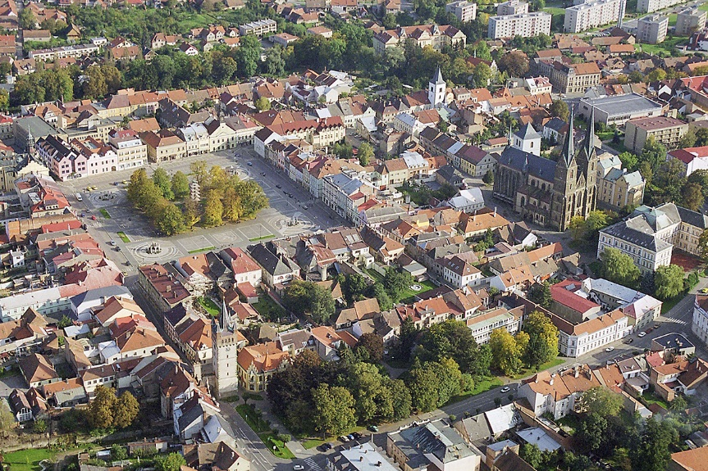
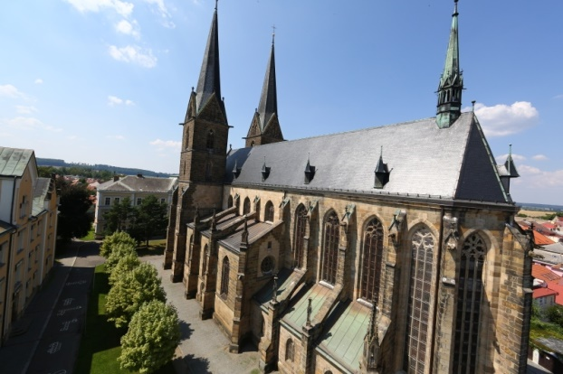
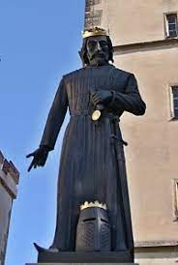
VYSOKÉ MÝTO
Basic school
(main bulding)
(next bulding)
Was founded by King Přemysl Otakar II called king of iron and gold because he mined iron and received the golden Bull of Sicily before the middle of the 13 th century

Slide 4
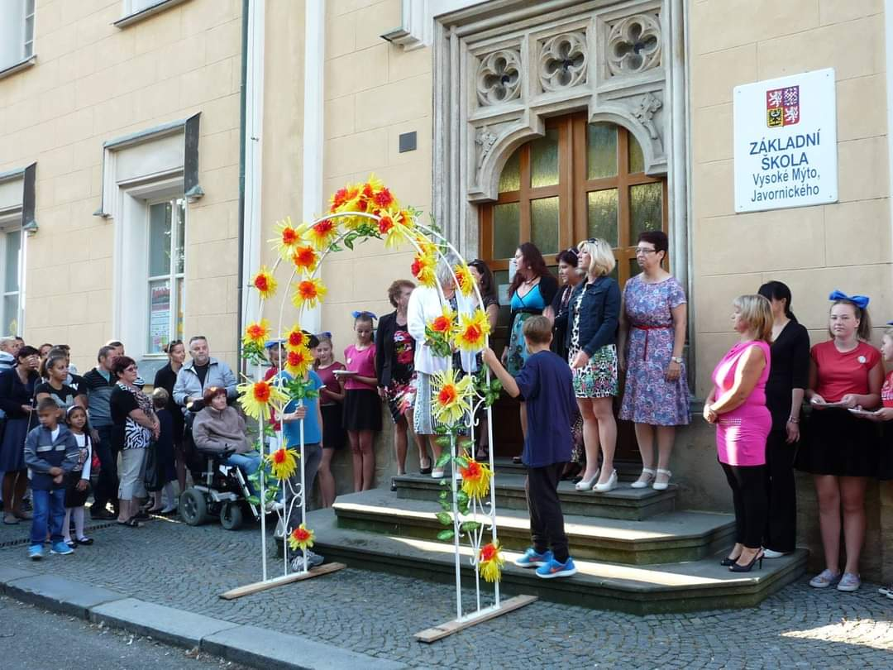
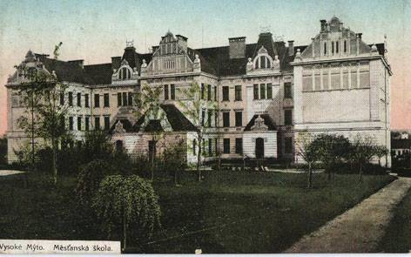
Our school
In our school there are actually 670 children and 43 teachers.
School was bulit in 1905, it‘s 118 years from its foundation. Since 2018‘s Mrs Jana Vavřinová the school director . We have 3 computers classrooms and school canteen with delicious warm lunches.
The school motto is:
We enjoy making children happy and knowledgeable.

Slide 5
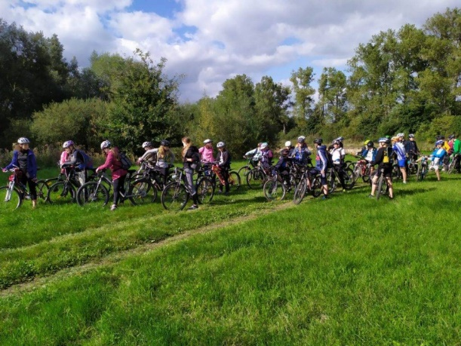
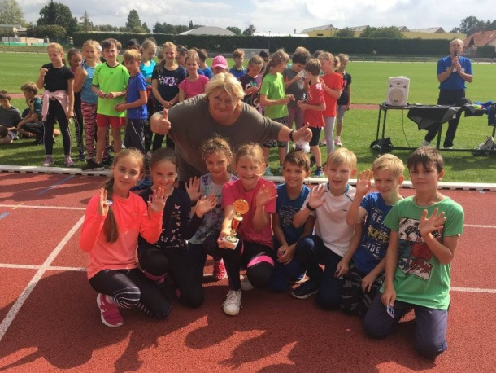
Our school
We still have work to do: school olympics, many excursions, an adaptation course, a skiing course, a cycling course, a cannoying course, a swimming course, a school in nature, Erasmus and a lot of others games and activities. We are proud of our school band, that performs at majority school events.

Slide 6
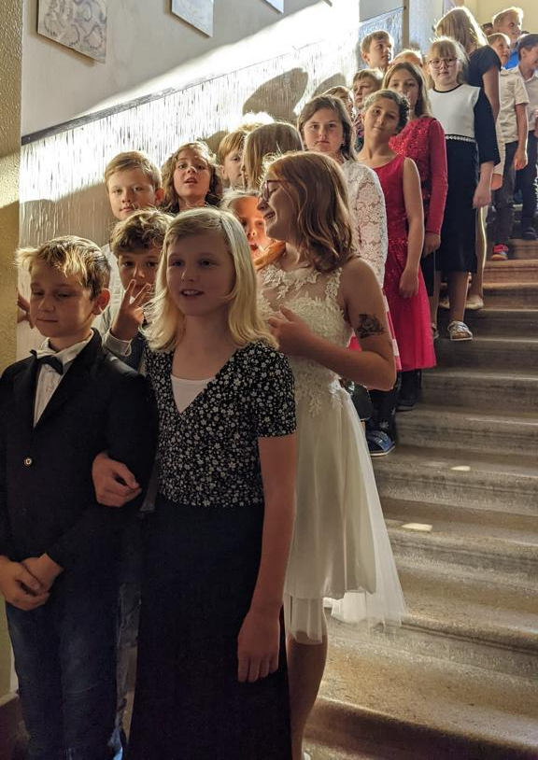
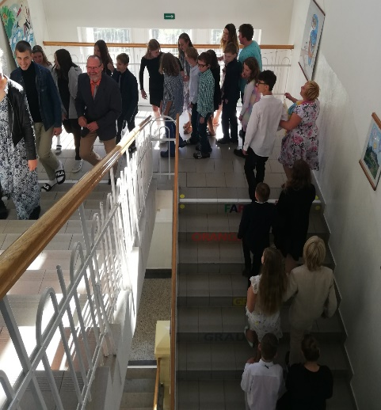
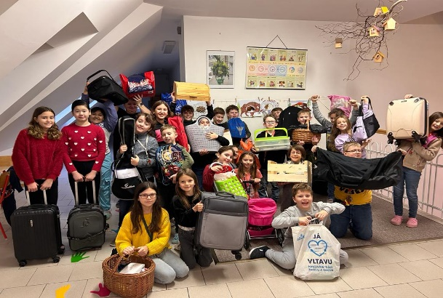
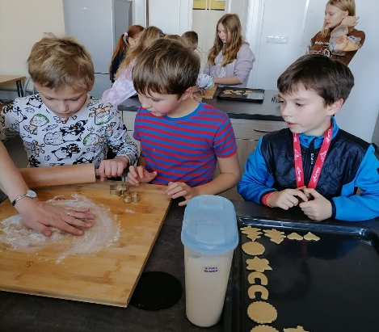
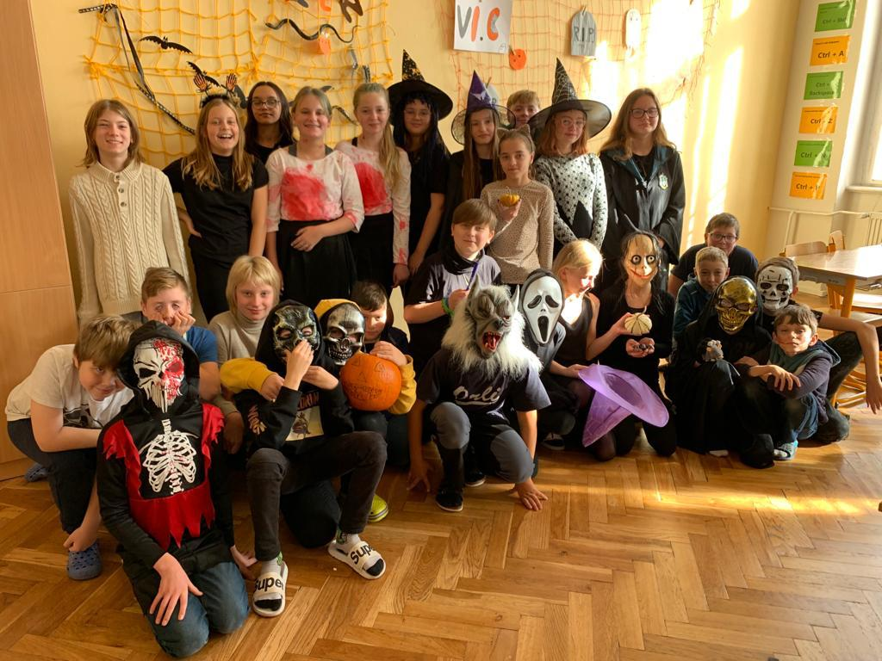
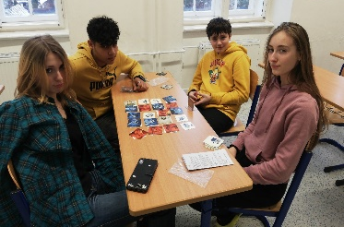
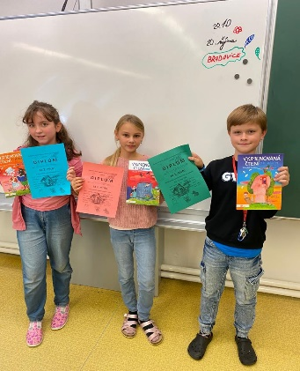
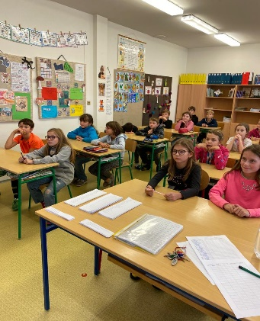
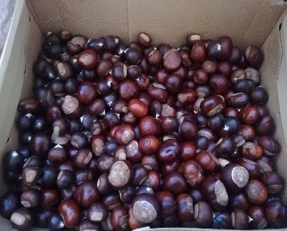
Our school -ACTIVITIES
Our school parliament always comes with something new to do: As our a day in party dress, Halloween, food for animals, competitions in language skills, visits at Seniors institutes, day without school bags, board games etc.

Slide 7
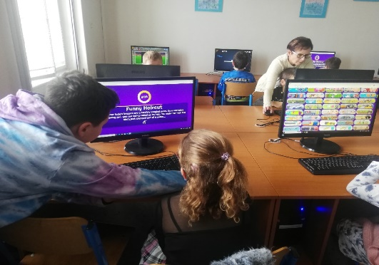
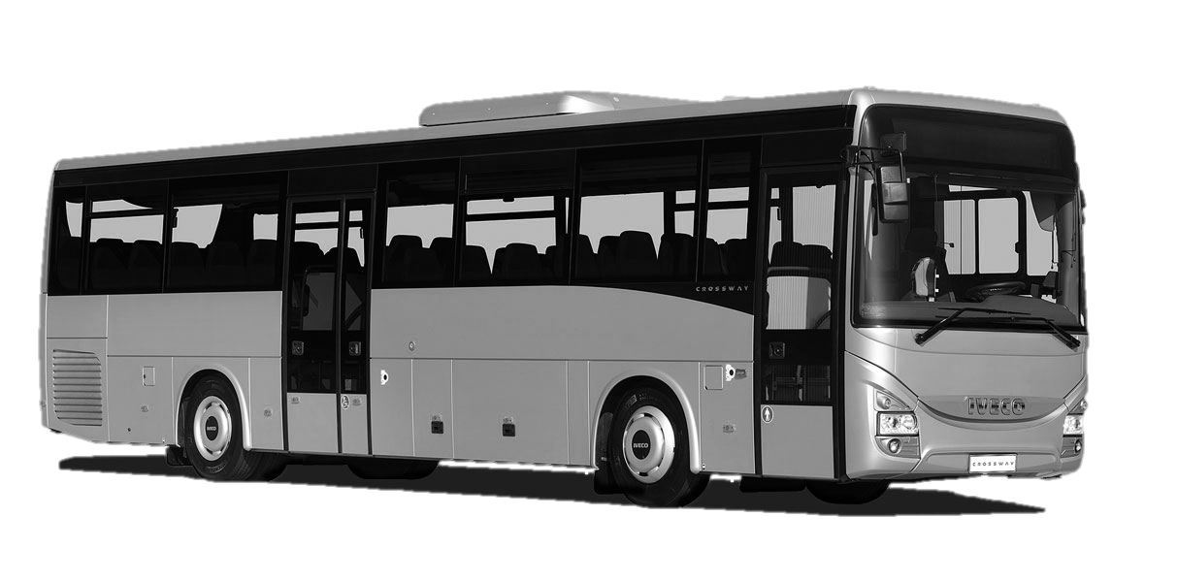
Our school AND CITY
For teachers there are many projects and education trainings to drive their future careers. Our school has a very good cooperation with the city authority and we help to developed and maintain the culture in our city.
In Vysoké Mýto seats the majour region‘s employer – company Iveco Czech republic, a.s. with 3900 workers. Iveco Bus produces apx. 22 buses per day, which makes 4768 buses per year.

Slide 8
Thank you for your attention.
More about us on:
www.zsjavornickeho.cz
Základní škola Vysoké Mýto, Javornického, příspěvková organizace
Markéta Kotasová

